Slide 1
Computer Science And IT
Abdal Ahmad

Slide 2
Introduction
In today's tech-driven world, understanding these fields is essential for career choices and collaboration.
Let's explore the distinct roles, focuses, and educational paths that make each of these disciplines unique

Slide 3
Computer Science
Definition: The science of computation, algorithms, and software principles.
Computation , information and automation
Principles and use of computers
Theoritical desipline
Algorithm , theory of computation ,
Practical disipline
design , implementation of hardware and software

Slide 4
Computer Science
What is computer ,
How it works
How it is made how it is designed
Its components
And how all process is done

Slide 5
Information Technology
Definition: Practical application of computer systems and technology.
Key Focus: Application-oriented, managing systems, and networks.
Core Areas: Networking, cybersecurity, hardware maintenance, and tech support.

Slide 6
Information Technology
IT is used to create data and information
Managing and implementing technology system
And to store , save , to send from one system to another , to retrieve , or exchange
We created the computer system through the computer science ,
But to maintain and trouble shoot , network system, security , Database management

Slide 7

Exchange of data and information

Slide 8

Computer System and Networking

Slide 9

Security Practice

Slide 10
Focus and Purpose
IT: Practical application of technology for information processing and communication.
CS: Theoretical study of computation, algorithms, and software principles.

Slide 11


Slide 12
IT: Practical skills in networking, cybersecurity, and hardware maintenance.
Programming language Python
Troubleshooting methods
Network configuration
Security infrastructure: Firewalls and routing setting
Ethical hacking and penetration testing
Data administration: Master in SQL

Slide 13
CS: Theoretical concepts, algorithms, and programming languages
Programming language
java , C/C++ , python ,etc
HTMl , CSS, javascrip
Data structure & Algorithm
COA (computer architecture & organization)
OS
Software Engineering
Artificial intelligence: Machine learning , Deep Learning
Data analysis , Database and tools : SQL

Slide 14
Problem-Solving Approach
IT: Practical hardware/software maintenance and troubleshooting.
CS: Complex problem solving through algorithms and computation.

Slide 15
Skills and Roles in
Computer science

Slide 16
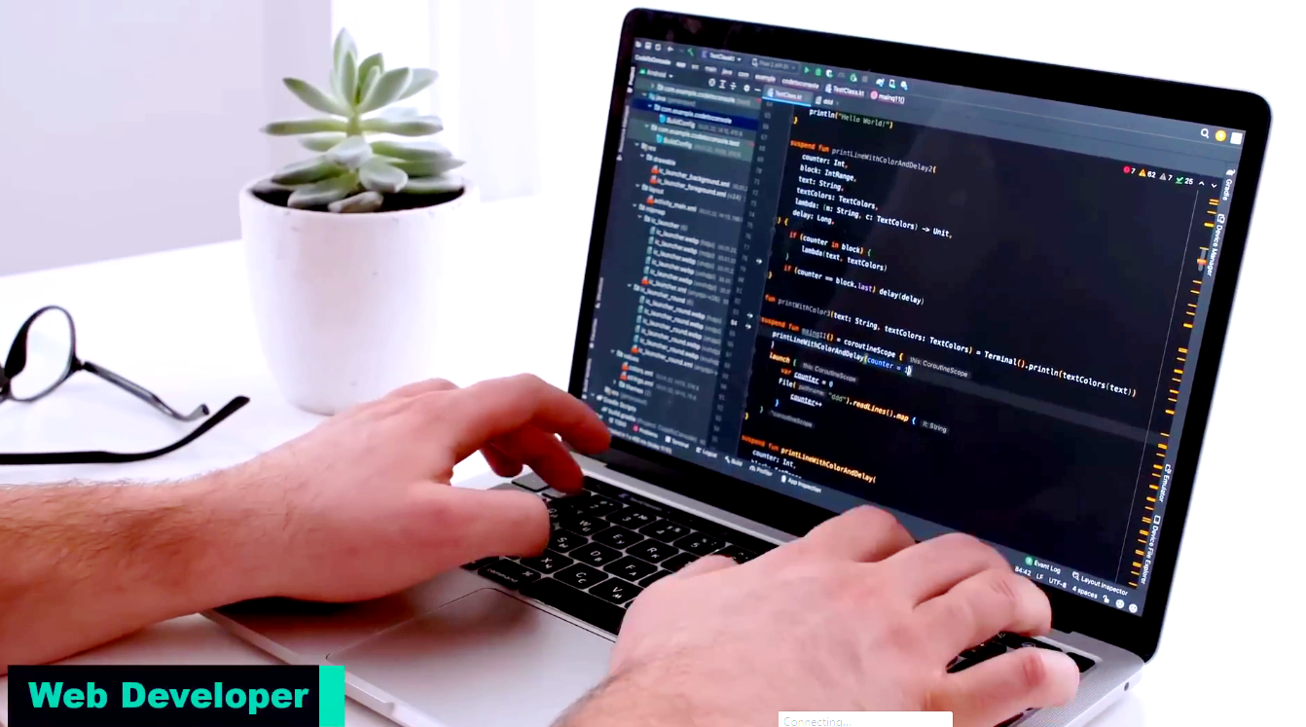
Web Developer

Slide 17
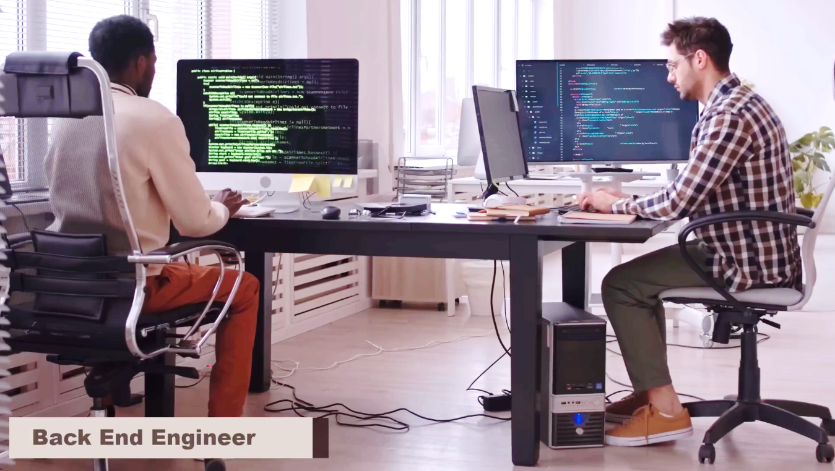
Back End Engineer

Slide 18
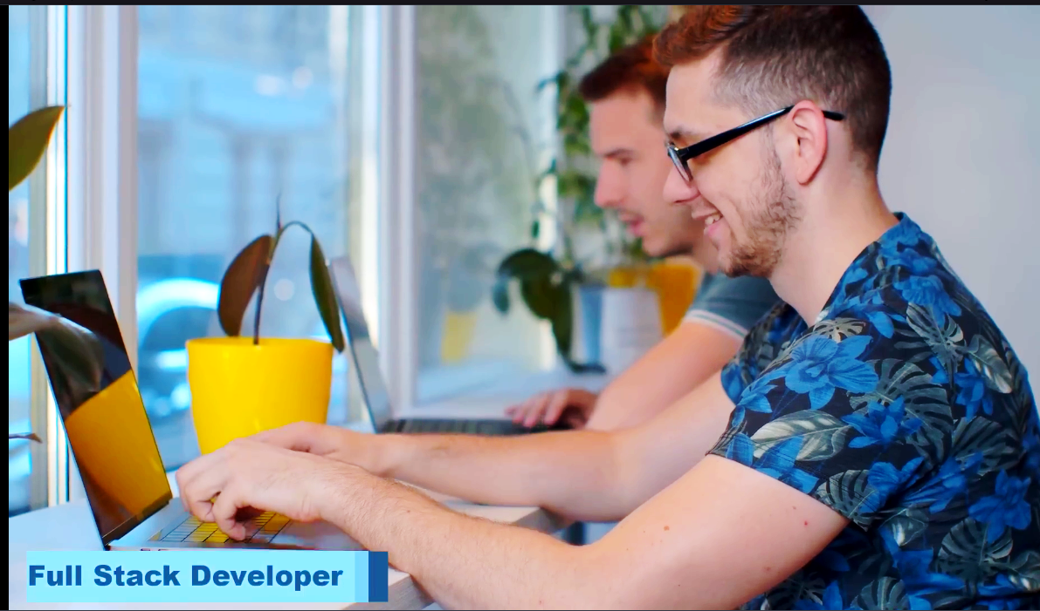
Full Stack Developer

Slide 19
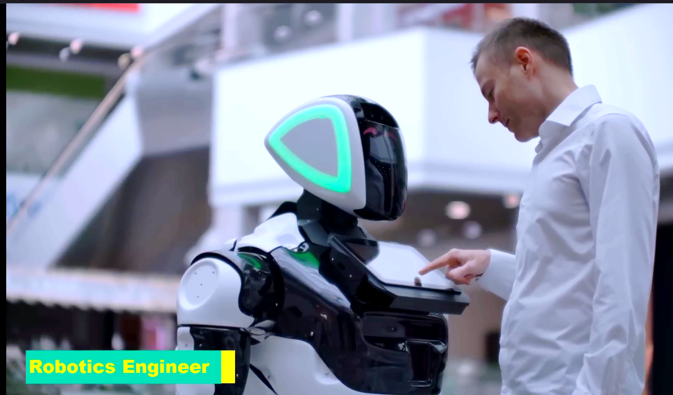
Robotics Engineer

Slide 20
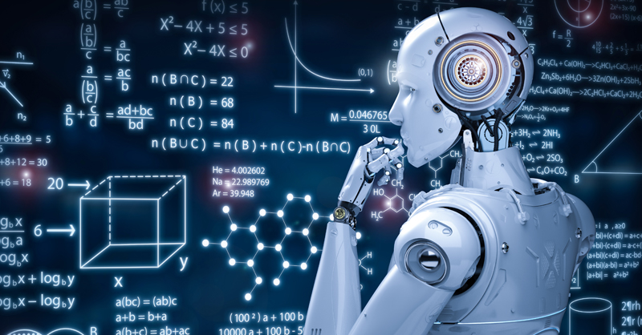
machine learning engineer

Slide 21
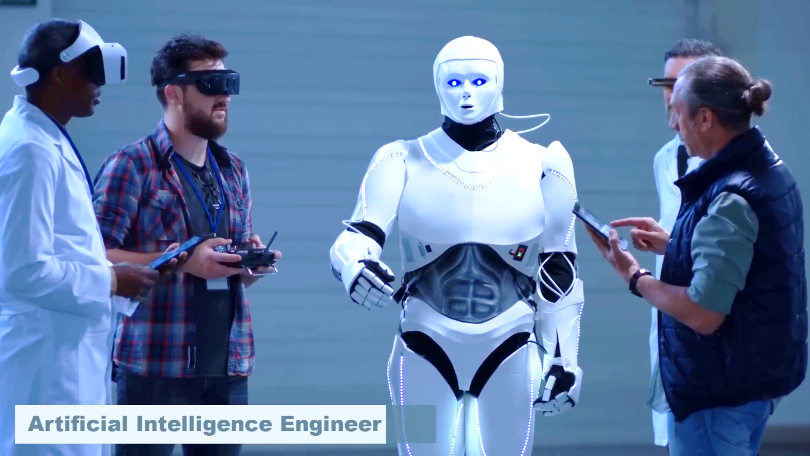
Artificial Intelligence Engine

Slide 22
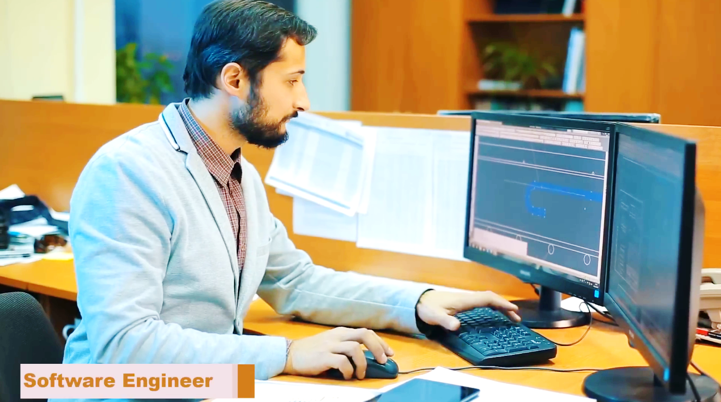
Software Engineer

Slide 23
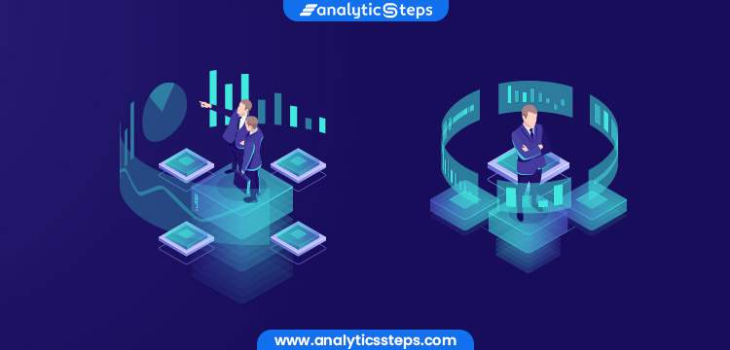
Data Scientist and Analists

Slide 24
Skills and Roles in
Information Tech

Slide 25


Slide 26
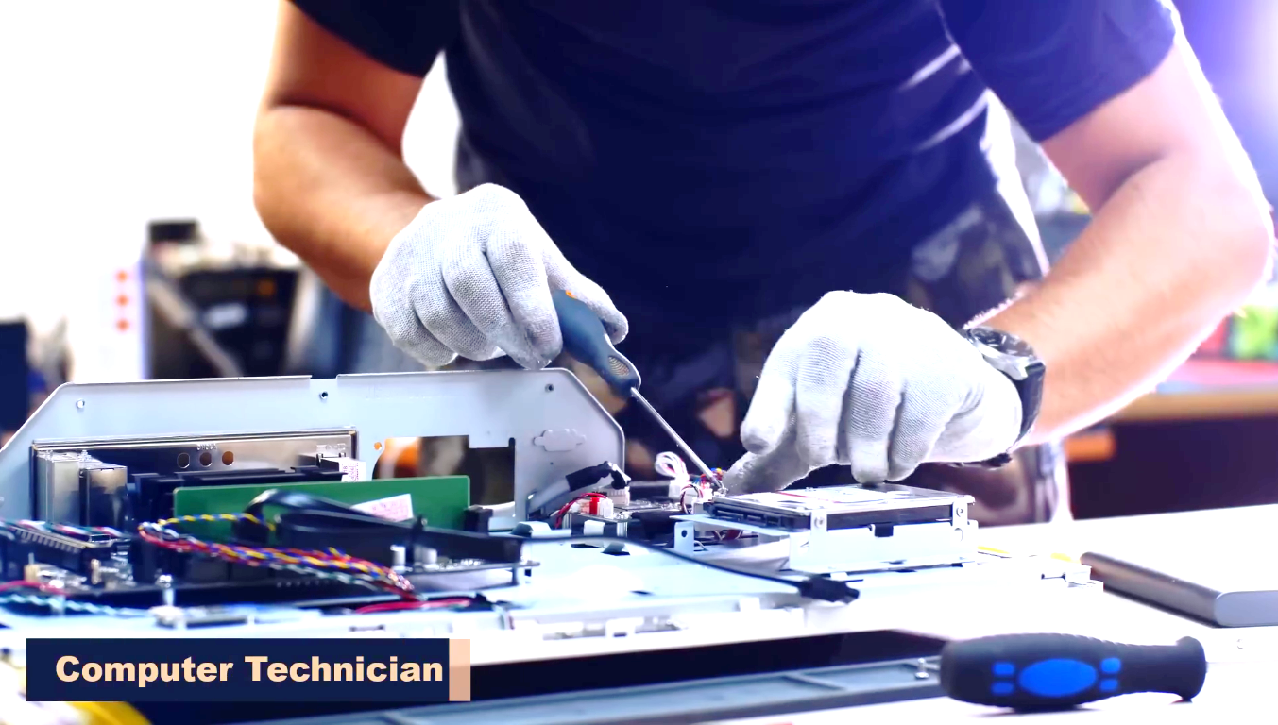

Slide 27
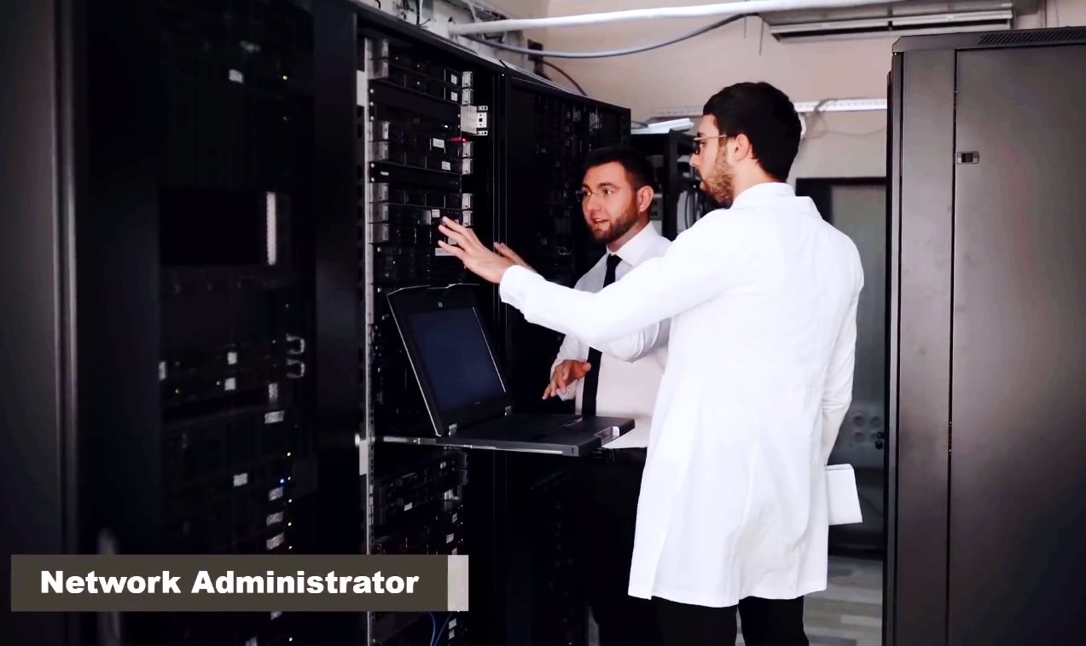

Slide 28
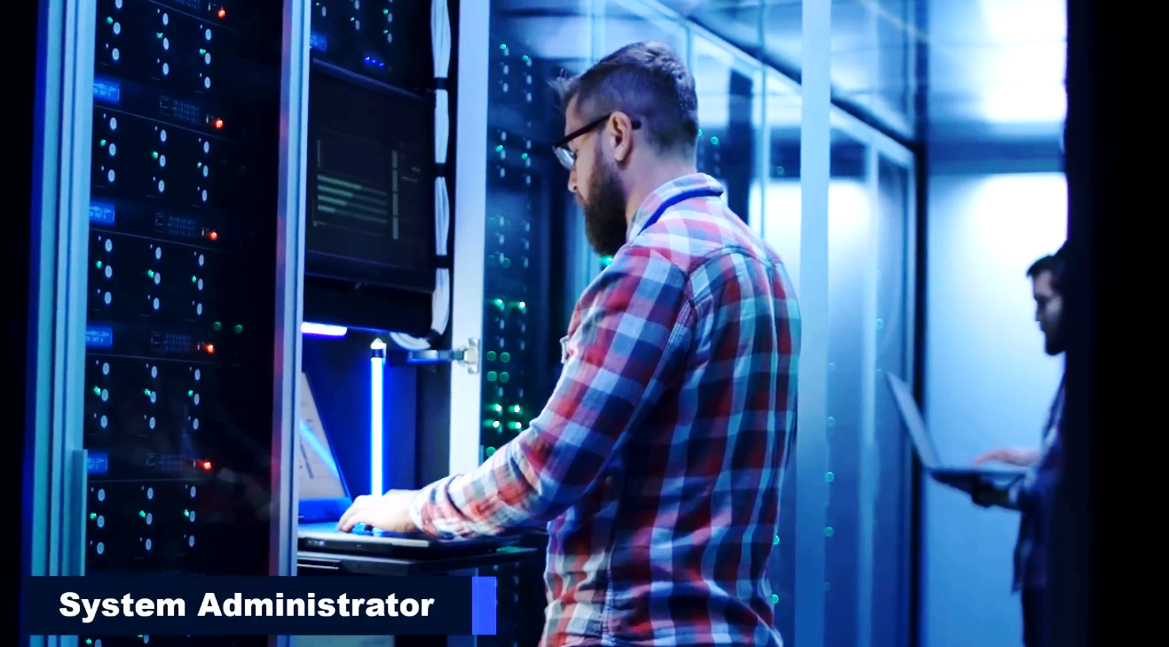

Slide 29
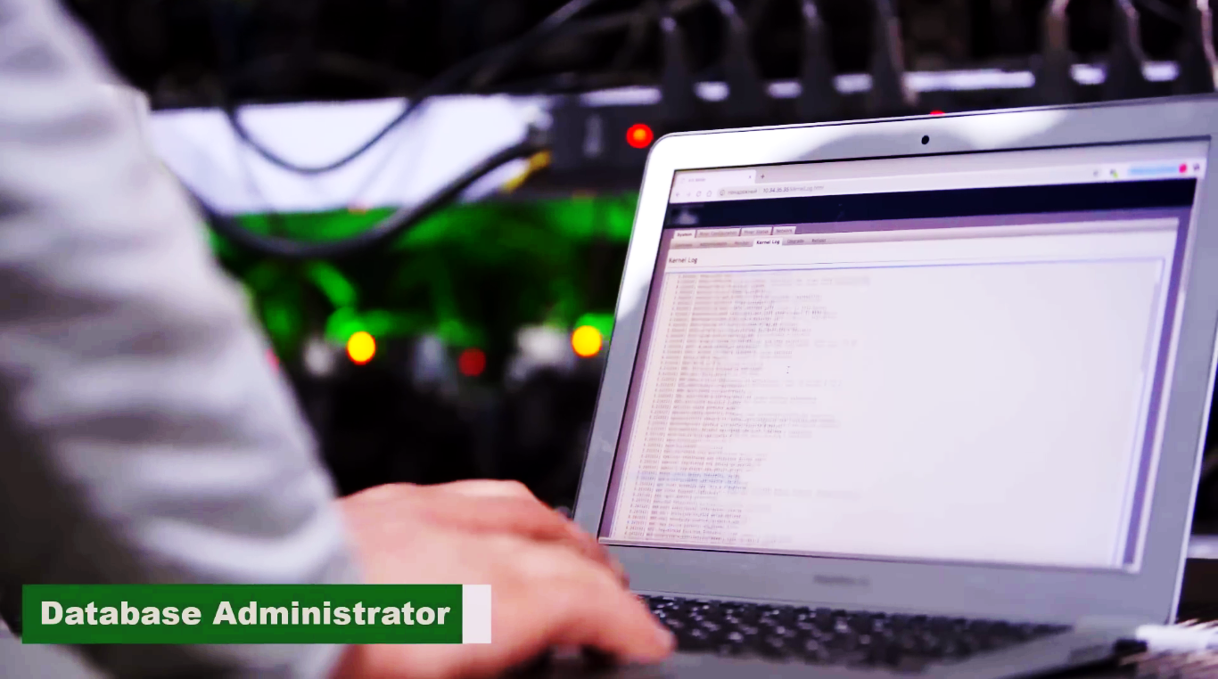

Slide 30


Slide 31


Slide 32

IT Consultant

Slide 33
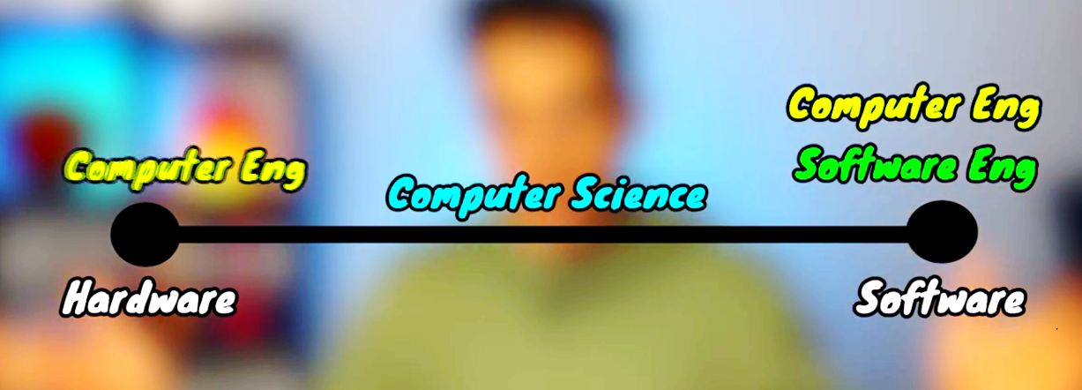

Slide 34


